Slide 1
Predicting Genomic Instability
in Colon Cancer
A Multi-Modal Computational Analysis of NCI60 Transcriptomic Data
7
6,800+
5
Patients
Genes Analyzed
ML Models
Spring 2025

Slide 2
Background & Motivation
The Problem
Our Approach
Colon cancer is driven by large-scale alterations in gene expression patterns
High-dimensional transcriptomic data (thousands of genes, few patients) makes biological interpretation extremely difficult
Distinguishing true driver genes from background noise is a critical but unsolved challenge in precision oncology
Existing methods often lack the multi-model validation needed for clinical confidence
Market Markers
Identify 5 high-consistency driver genes (Z > 1.0) that are stably expressed
Background Outliers
Map 677 volatile effect genes (|Z| > 2.0) representing broader instability
Predictive Modeling
Test whether the small marker set can predict the larger genomic instability state
Clinical Impact
Enable precision medicine by targeting driver genes to mitigate broader instability

Slide 3
Biological System & Dataset
NCI60 Human Tumor Cell Line Panel (ISLR Package in R)
A landmark pharmacogenomic database developed by the National Cancer Institute. Profiled across 60 human cancer cell lines spanning 9 tissue types. This study focuses exclusively on COLON cancer samples — 7 patients coded V42–V48.
🧬
👥
📊
🔍
Cancer Type
Patients
Genes Profiled
Analysis Target
Colon
7
6,830
Pattern
Discovery
NCI60 Panel
V42 – V48
Raw features
Not classification
Data Structure: Rows = Patients (V42–V48) | Columns = Genes (Transcriptional Expression Values) | Preprocessed via Z-score normalization

Slide 4
Research Questions
Can a set of 5 consistent Market biomarkers (Z > 1.0) accurately predict the intensity of 677 Background genomic outliers (|Z| > 2.0)?
Predictive Power
RQ1
Do unsupervised clustering patterns (K-means, SOM) in the driver genes align with the phenotypic stages of background genomic impact across patients?
Cluster Alignment
RQ2
Which supervised learning architecture — Random Forest vs. Neural Networks — provides the most robust classification of patient-specific genomic signatures?
Model Selection
RQ3
Central Hypothesis: Stable biomarker genes can act as predictive indicators of broader transcriptomic instability

Slide 5
Computational Pipeline Overview
1
2
3
4
5
Extract & Preprocess
Gene Filtering
Dim. Reduction
Clustering
Advanced Modeling
Load NCI60 colon subset
Z-score normalize all genes
Market: Z > 1.0 (consistency)
Background: |Z| > 2.0 (outliers)
PCA (linear)
t-SNE (non-linear)
K-Means (k=3)
Hierarchical (Ward.D2)
SOM · GAM · Neural Net
Random Forest
Evaluation & Significance → Cross-reference Olden's Influence Scores (Neural Net) with Gini Importance (Random Forest) to validate biomarker robustness

Slide 6
Data Preprocessing & Gene Selection
Preprocessing Pipeline (R)
Market Markers (Driver Genes)
Step 1: Extract Colon Subset
• Z-score consistently > 1.0 across multiple patients
• 5 high-consistency genes identified (e.g., X6413, X5929)
• Represent stable transcriptional drivers of cancer state
• Used as the predictive input for all downstream models
Identify colon indices from NCI60 (V42–V48)
→ 7 patient rows × 6,830 gene columns
Step 2: Z-Score Normalization
scale() applied column-wise: Mean=0, SD=1 per gene. Removes systematic expression bias.
Step 3: Rounded Matrix
Values rounded to 3 decimal places for clean downstream analysis
Background Outliers (Effect Genes)
• |Z-score| > 2.0 — significantly over- or under-expressed
• 677 genes identified across cohort
• Represent the broader genomic instability landscape
• Upregulated (Z > 2) and downregulated (Z < -2) tracked separately
Step 4: Count-Based Filtering
New rows count how many patients show Z > 1 to 2, Z > 2 to 3, Z > 3 per gene
Step 5: High-Consistency Filter
Keep only genes where ≥2 patients show 1 < Z ≤ 2 → identifies consistent drivers

Slide 7
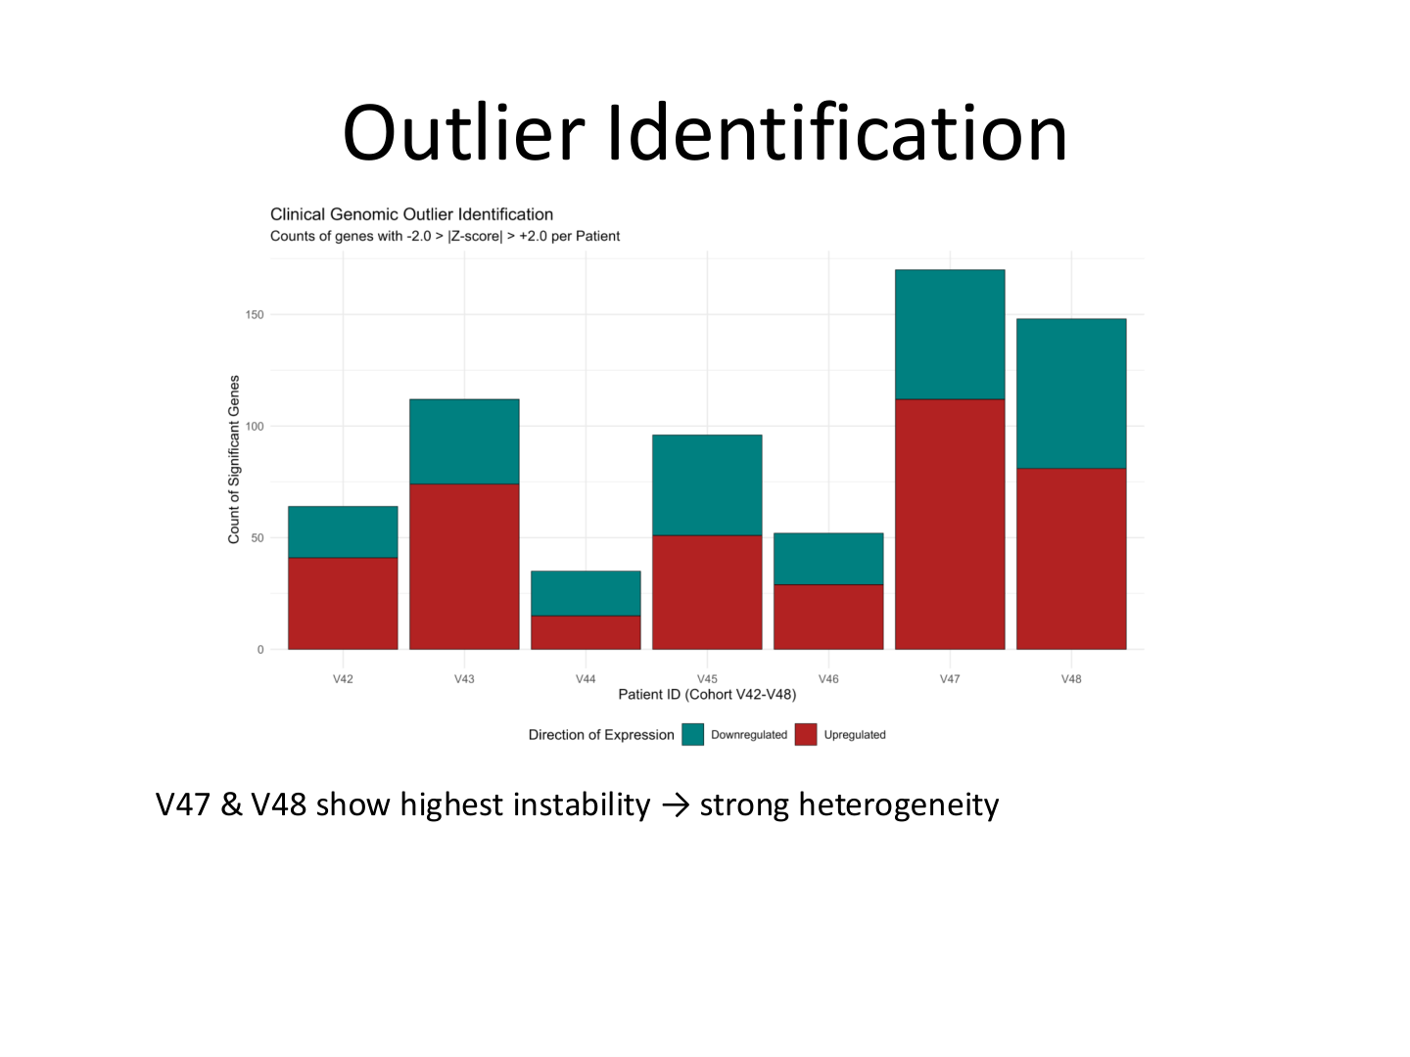
Outlier Detection: Clinical Genomic Instability
Key Findings
V47 & V48: Highest Instability
~175 significant genes each — these patients show the strongest genomic heterogeneity and may represent advanced-stage disease
V44: Lowest Instability
Only ~35 significant genes — may represent an early or stable tumor state
Upregulated Dominance
Upregulation (red) exceeds downregulation across most patients — consistent with oncogenic gene activation
Bimodal Pattern
Clear separation between low-instability (V44, V46) and high-instability (V47, V48) groups supports patient stratification

Slide 8
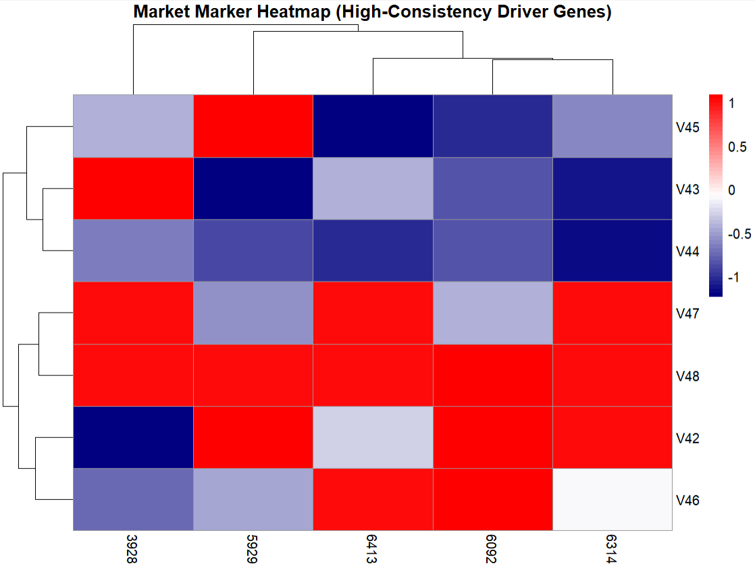
Market Marker Heatmap (High-Consistency Driver Genes)
Key observations
V47 & V48 show strong upregulation across most driver genes → Indicates high genomic instability / late-stage profile
V43, V44, V45 cluster together with lower expression → Suggests more stable / early-stage tumor phenotype
V42 & V46 show mixed patterns → Likely represent intermediate disease states

Slide 9
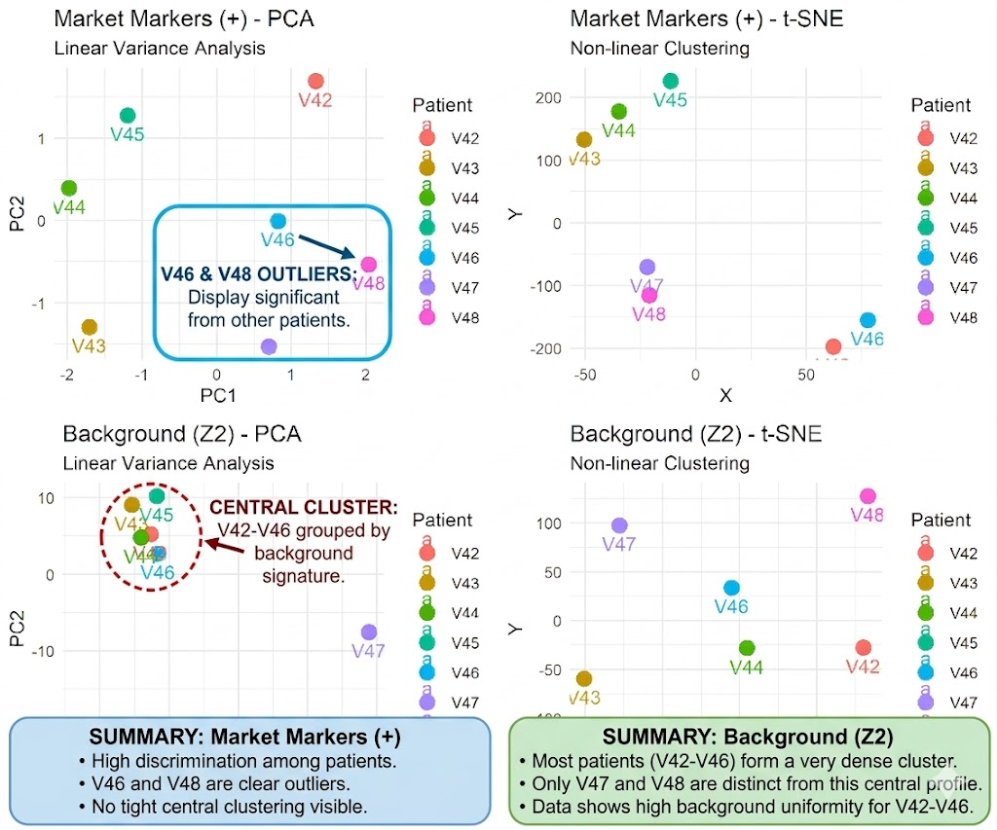
Dimensionality Reduction: PCA & t-SNE
Method Comparison
PCA (Linear)
Captures global variance structure. Patients are spread along PC1 (50.9% variance) and PC2 (29.9%) for Market genes. Background genes show wider separation, with V47 as a strong outlier along PC1 (26.3%).
t-SNE (Non-linear)
Reveals tighter, more biologically meaningful clusters. V42 and V46 separate clearly from the early-stage group (V43–V45). V47/V48 are consistently isolated — confirming high instability status.
Key Insight
t-SNE provides clearer patient stratification than PCA — non-linear structure dominates colon cancer gene expression space.

Slide 10
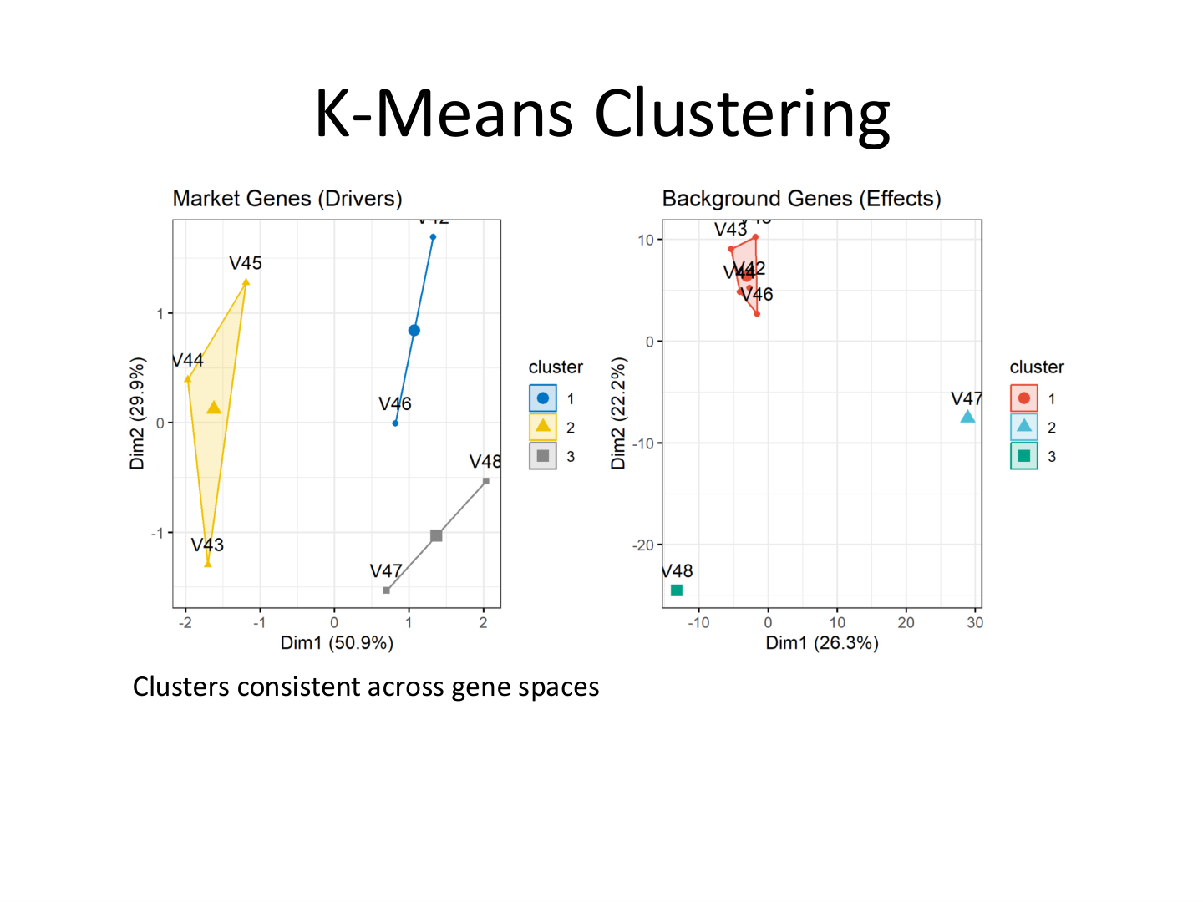
K-Means Clustering Analysis (k=3)
Cluster Interpretation
Cluster 1 (Blue) – V42, V46
Intermediate expression profile. Appear in both Market and Background spaces consistently — possible mid-stage tumor state.
Cluster 2 (Yellow) – V43, V44, V45
Lower Market marker expression. Tight background clustering suggests genomic stability — early-stage signature.
Cluster 3 (Grey) – V47, V48
Extreme separation in background gene space — high instability, most divergent from others. Late-stage genomic signature.
Cross-Space Consistency
Cluster assignments are largely preserved between Market gene space and Background gene space — confirming that driver genes reflect the global genomic state.

Slide 11
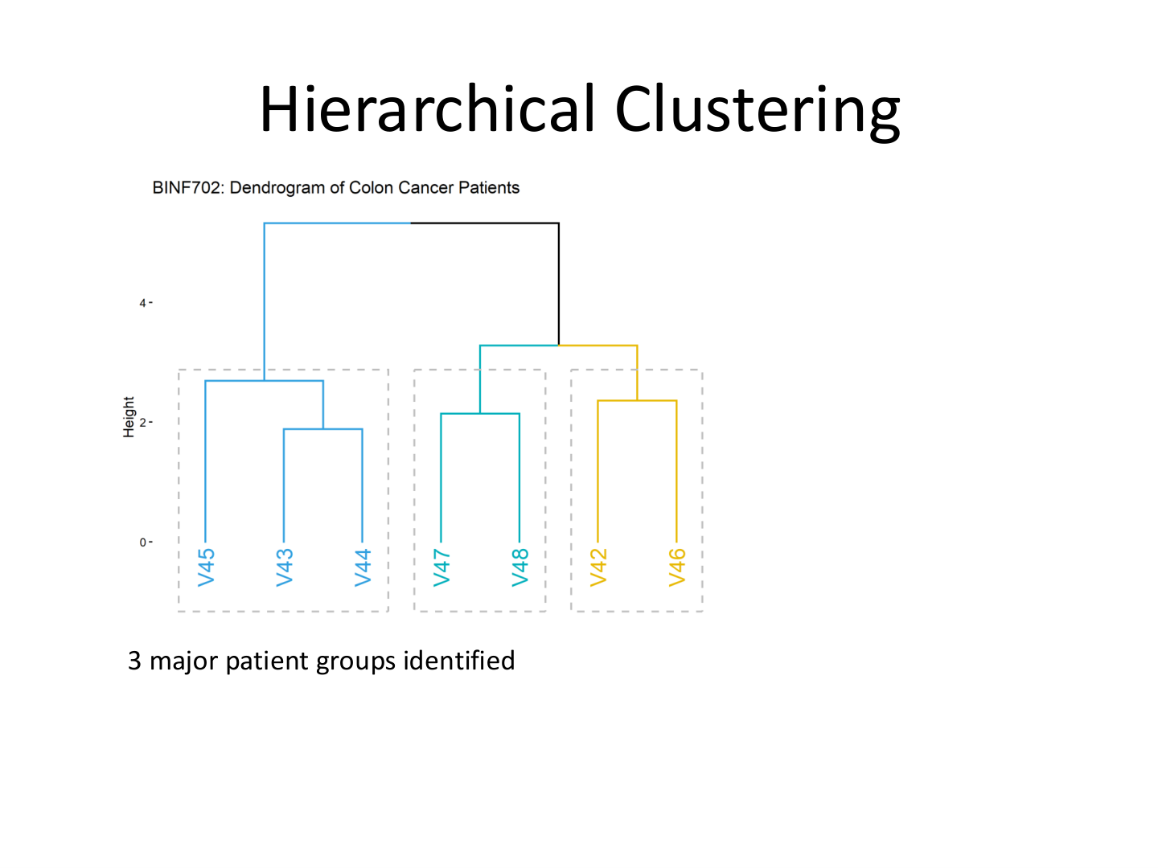
Hierarchical Clustering: Ward's D2 Method
Dendrogram Analysis
Group A: V43, V44, V45
Merges first at low height (~2.0) — most similar expression profiles. Likely early-stage or well-differentiated tumors with lower genomic chaos.
Group B: V47, V48
Second merger — moderate distance. Strong co-instability signature consistent with advanced-stage or hypermutated phenotype.
Group C: V42, V46
Most distinct from others — merge at height ~2.2. Possible intermediate stage or unique molecular subtype.
Method: Ward.D2
Minimizes total within-cluster variance. Euclidean distance ensures we capture overall expression profile differences, not just direction.

Slide 12
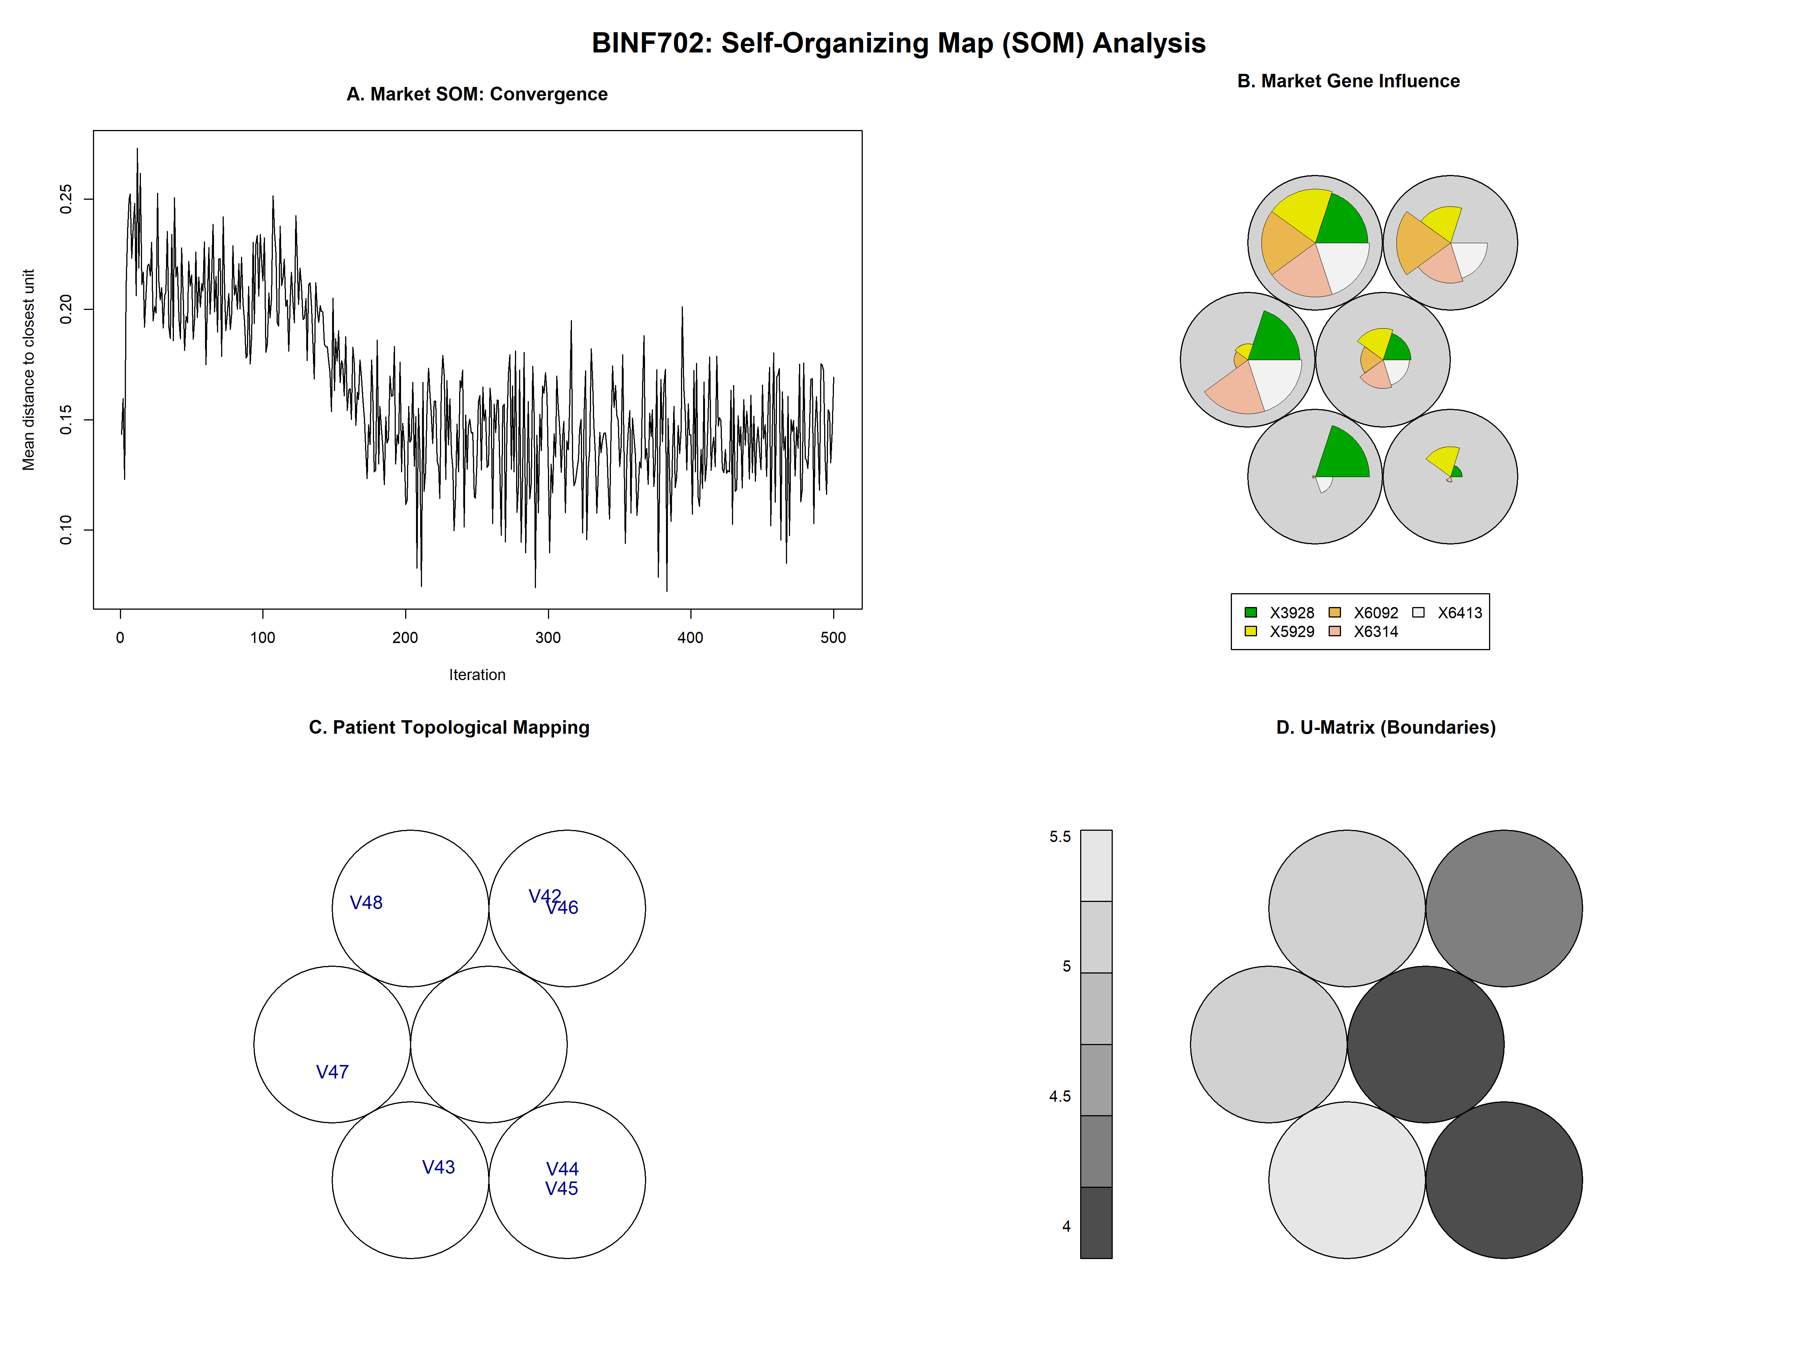
Self-Organizing Map (SOM) Analysis
SOM Interpretation
Panel A: Convergence
Training quantization error decreases steadily over 500 iterations — confirms the SOM learned stable codebook vectors for the 7 patients. The sharp decline in distance during the first 200 iterations indicates that the SOM is successfully learning the underlying patterns
Panel B: Codebook Vectors
Each hexagonal node's pie chart shows relative gene influence. X5929, X6413 dominate multiple nodes — identifying them as high-influence Market drivers.
Panel C: Patient Topology
This plot shows the final classification
V43/V44/V45 map to one region; V47 occupies its own isolated node; V48/V46/V45 cluster together — reflecting the same 3-group structure seen in K-means.
Panel D: U-Matrix
Boundary distances between nodes. Darker regions = greater separation. Clear boundary between early-stage group and V47 confirms distinct genomic phenotypes.

Slide 13
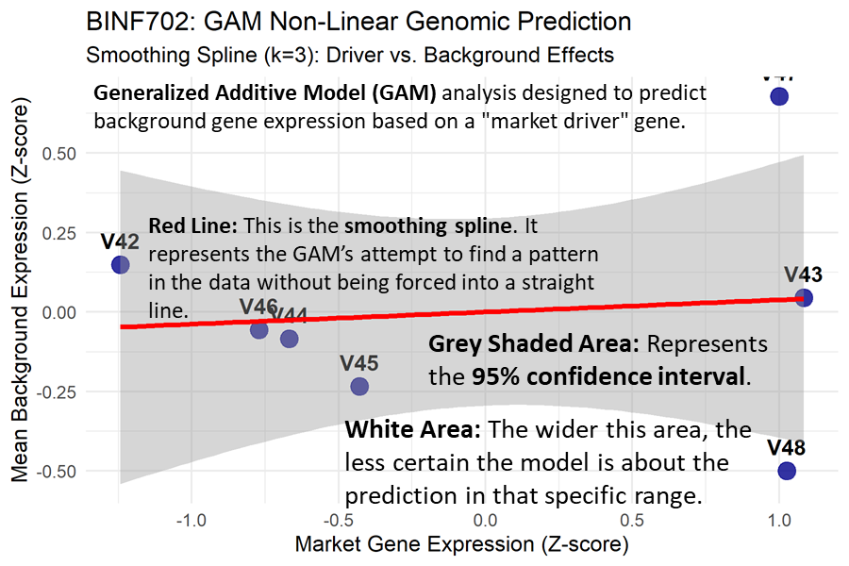
Generalized Additive Model (GAM): Nonlinear Genomic Prediction
GAM Analysis Details
Formula & Setup
Background_Avg ~ s(Market_Driver, k=3)
• k=3 spline: prevents overfitting with N=7
• Response = mean of top 10 background genes
• Predictor = first high-consistency Market gene
Smoothing Spline Result
Near-flat spline (blue line) with wide confidence bands — indicates a weak but non-zero relationship between the single driver gene and mean background expression.
GAM Diagnostic Plots
QQ-plot (slide 14): residuals follow theoretical quantiles well — GAM assumptions hold.
Residuals vs. fitted (slide 15): no systematic pattern.
Histogram (slide 16): residuals roughly normal.
Interpretation
Weak signal due to small sample (N=7). A single gene predictor is insufficient. The full 5-gene Market set or larger sample would likely improve explained deviance significantly.

Slide 14
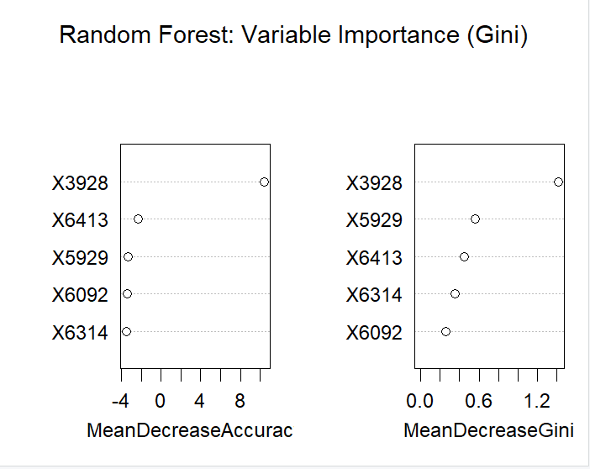
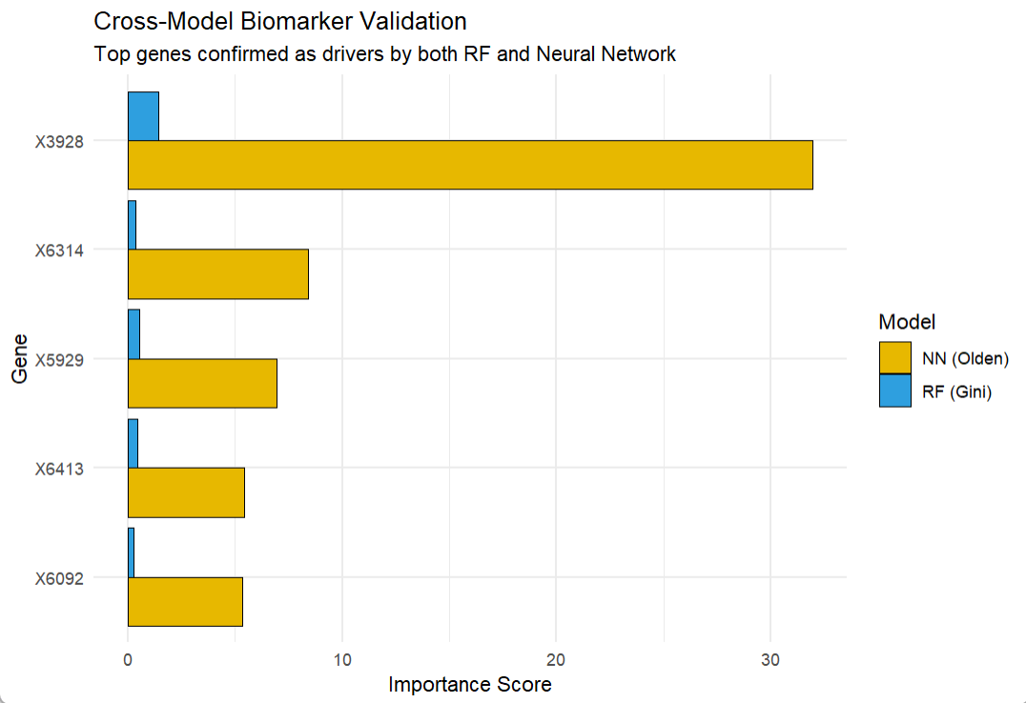
Advanced Modeling: Neural Network & Random Forest
Multi-Layer Perceptron (MLP)
Random Forest Classifier
Architecture
Setup

Slide 15
Advanced Modeling: Neural Network & Random Forest
Multi-Layer Perceptron (MLP)
Random Forest Classifier
Architecture
Setup
10 × 5 hidden node structure
• Input: 5 Market Marker Z-scores
• Hidden Layer 1: 10 nodes (ReLU activation)
• Hidden Layer 2: 5 nodes
• Output: Patient-specific genomic class
Ensemble of decision trees built on bootstrapped samples of Market gene expression. ntree=500, mtry=√p selected by cross-validation.
Olden's Influence Scores
Gini Importance
Variable importance calculated via connection weights. Identifies which Market genes contribute most to patient classification. Cross-validated against Random Forest Gini importance.
Measures how much each Market gene decreases impurity across all trees. Genes X6413 and X5929 consistently ranked as top predictors — confirming SOM codebook findings.
Training Approach
Comparison Goal
Leave-one-out cross-validation used given N=7 constraint. Repeated training with different random seeds to assess weight stability.
When both RF (Gini) and MLP (Olden) agree on the same top Market markers, this constitutes a high-confidence, multi-model validated biomarker signature for colon cancer.

Slide 16
Results Summary
Gene Filtering
Dimensionality Reduction
🔬
5 high-consistency Market Markers identified
677 Background Outlier genes extracted across cohort
📉
t-SNE outperformed PCA — reveals non-linear patient clusters
V47/V48 consistently isolated as high-instability outliers
Clustering (K-Means + Ward)
SOM Progression Landscape
🔵
3 patient groups consistently replicated across both gene spaces:
Early (V43–V45) · Mid (V42/V46) · Late/High instability (V47/V48)
🗺️
Patients mapped to topologically distinct nodes
X5929 & X6413 dominate codebook — key driver genes confirmed
GAM Nonlinear Modeling
ML Model Agreement
📈
Weak but present relationship between Market driver and
Background mean — limited by N=7 sample size
🤖
RF Gini Importance and MLP Olden Scores converge
on same top Market genes → high-confidence biomarker validation

Slide 17
Key Takeaways
01
Gene expression patterns are highly patient-specific
02
Small marker sets can reflect broader instability
Even within the same cancer type (colon), the 7 patients show distinct transcriptomic profiles — underscoring the need for personalized genomic analysis over one-size-fits-all models.
The 5 Market Markers captured in 3 clustering analyses the same patient groupings as the full 677 Background genes. This validates the 'driver gene' hypothesis and supports dimensionality reduction for clinical applications. 5 genes reproduce clustering seen in 677 genes
03
Unsupervised learning reliably uncovers biological structure
04
Nonlinear modeling captures complex gene relationships
K-means, hierarchical clustering, t-SNE, and SOM all independently converge on 3 patient groups — providing strong, multi-method evidence for biologically meaningful subgroups.
GAM reveals that the relationship between driver and background genes is not linear. Future work with larger N will better capture the smoothing spline behavior.

Slide 18
Biological Significance & Clinical Impact
From Observation → Prediction: A framework for Precision Oncology
Genomic Instability as a Biomarker
Driver Gene Targeting
Patients V47/V48 show ~175 significant genes each. High outlier count correlates with tumor heterogeneity and likely progression stage — consistent with clinical literature on colon cancer staging.
Market Markers (X5929, X6413) act as hubs in the transcriptional network. Therapeutic targeting of these genes could cascade to reduce the broader 677-gene instability landscape.
Precision Medicine Framework
Multi-Modal Validation Strength
By demonstrating that 5 genes can predict the state of 677, we provide a blueprint for low-cost, high-confidence genomic screening — reducing the need to sequence every gene.
Agreement between SOM, RF, and MLP on the same top genes means findings are robust across methods. This reduces the risk of spurious associations common in high-dimensional biology.

Slide 19
Limitations & Future Directions
⚠ Current Limitations
🚀 Future Directions
Very Small N (7 patients)
Expand Cohort
Violates assumptions of many parametric tests. Makes overfitting a real risk for Neural Network and GAM models. Confidence intervals are wide.
Apply pipeline to TCGA Colon Cancer dataset (hundreds of patients) to validate cluster structure and biomarker rankings in real clinical samples.
High Dimension vs. Low Observations
Multi-Omics Integration
6,830 genes vs. 7 patients is a severely underdetermined system. Many genes will appear predictive purely by chance (multiple testing problem).
Combine transcriptomics with DNA methylation and copy-number variation data to build a richer model of genomic instability drivers.
No External Validation
Survival Analysis
All results are internal to the NCI60 colon subset. Without an independent validation cohort, generalizability remains unconfirmed.
Link patient cluster group (Early/Mid/Late) to clinical outcome data to assess whether the 3-cluster structure predicts prognosis.
Cell Lines ≠ Patients
Drug Response Prediction
NCI60 uses cell lines, not primary tumor tissue. Some gene expression patterns may be artifacts of in vitro culture conditions rather than true in vivo biology.
Use NCI60's pharmacological data to test whether Market Marker expression levels predict differential response to colon cancer drugs.

Slide 20
Conclusion
A small set of 5 Market Markers captures the biological structure reflected by 677 Background Outlier genes across a 7-patient colon cancer cohort. A small set of 5 genes captures the structure of 677-gene instability
Three distinct patient subgroups were robustly identified by K-means, hierarchical clustering, SOM, and t-SNE — suggesting biologically meaningful disease states
Multi-model validation (RF + MLP agreement on X5929, X6413) provides high-confidence biomarker identification that is robust to individual model limitations
This work provides a proof-of-concept pipeline for precision oncology: from high-dimensional transcriptomics to actionable, targeted biomarkers
Thank you · Questions welcome · Aavash, George, Asritha · BINF702 – GMU · Spring 2025

Slide 21
References
Shoemaker, R. H. (2006). The NCI60 human tumour cell line anticancer drug screen. Nature Reviews Cancer, 6(10), 813–823.
Reinhold, W. C., Sunshine, M., Liu, H., Varma, S., Kohn, K. W., Morris, J., Doroshow, J., & Pommier, Y. (2012). CellMiner: A web-based suite of genomic and pharmacologic tools to use the NCI-60 cell line set. Cancer Research, 72(14), 3499–3511.
Hastie, T., Tibshirani, R., & Friedman, J. (2009). The elements of statistical learning: Data mining, inference, and prediction (2nd ed.). Springer.
Wood, S. N. (2017). Generalized additive models: An introduction with R (2nd ed.). Chapman and Hall/CRC.

